Slide 1
Evaluating the Direct, Indirect, and Community-level Effects of LLINs across Transmission Intensities
AIM Group Meeting
Zenabu Suboi
2nd March 2026

Slide 2
Outline
Introduction
Methods
Results
Key messages and recommendations
Feedback

Slide 3
Introduction

Slide 4
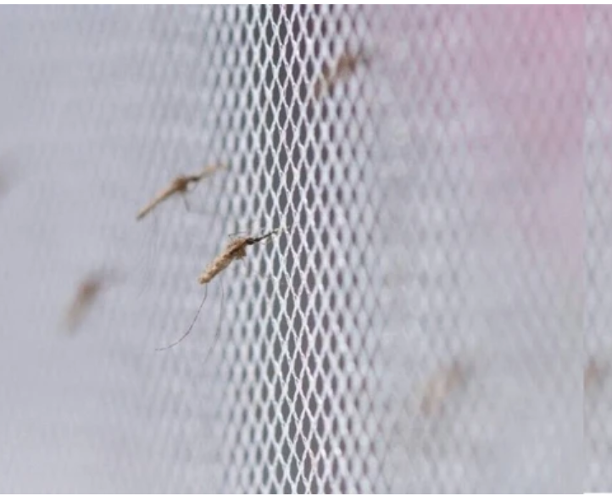
Background – LLIN effectiveness
Long lasting insecticidal nets (LLINs) have been attributed with averting 663 million clinical cases from 2000 – 2015
effectiveness of LLINs arises from two complementary mechanisms:
physical prevention of mosquito bites
insecticidal action that kills or deters mosquitoes

Slide 5
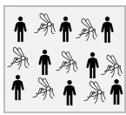
the concept of community protection
LLINs offer different benefits for users and non-users within a population
No LLIN use

Slide 6
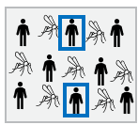
the concept of community protection
LLINs offer different benefits for users and non-users within a population
net-users receive personal protection
No LLIN use
X% LLIN use

Slide 7
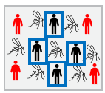
the concept of community protection
LLINs offer different benefits for users and non-users within a population
net-users receive personal protection
both users and non-users benefit from indirect (community) protection
reduced mosquito density, lifespan, and proportion of infectious mosquitoes
This concept is known as community protection
No LLIN use
X% LLIN use
Increased LLIN use
Notes:
Within OpenMalaria, bed nets act by modifying parameters of the mosquito feeding cycle model.
They reduce host availability,
decrease the probability of successful blood feeding following host contact, and
reduce the probability that a mosquito successfully finds a resting place after feeding

Slide 8
evidence of community protection
Evidence from both empirical and modelling studies
These evidences indicate that
indirect effects are heterogeneous and sensitive to local transmission dynamics, intervention coverage, and vector ecology
community protection from nets vary by spatial scale and local coverage levels in multiple African settings
Notes:
Western Kenya -60, Northern Ghana – 100-300, modeling study -10, 100
Multi-country DHS analysis - <20, 20-80, >80

Slide 9
what this study focuses on
the magnitude and reliability of community protection from LLINs remain incompletely evaluated across epidemiological settings
we use OpenMalaria to quantify the direct and indirect effects of LLIN usage across a wide range of transmission intensities

Slide 10
Methods

Slide 11
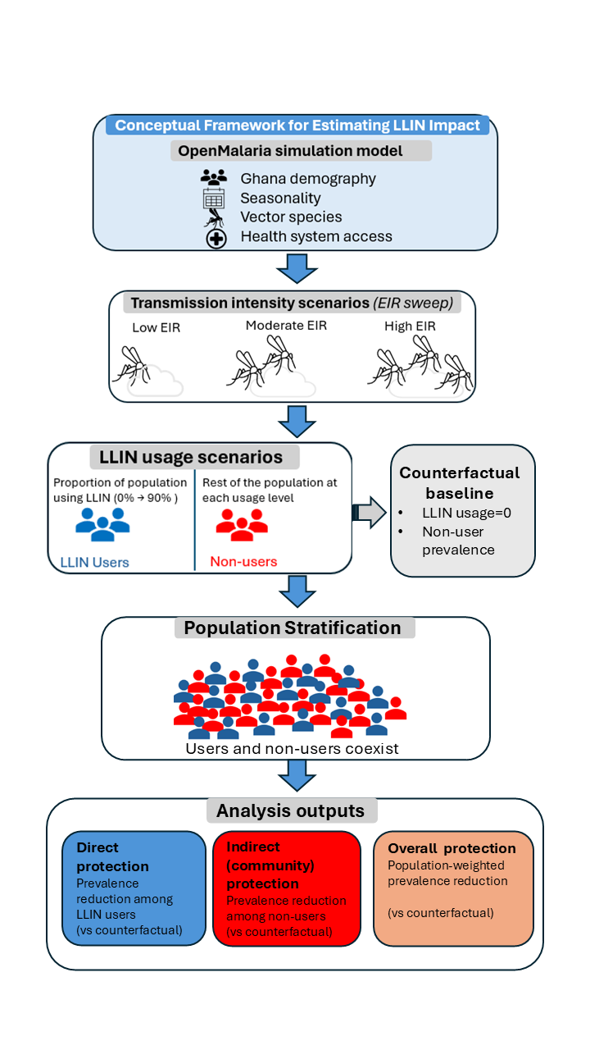
Methods
Notes:
Started from one district in the Oti region of Ghana – Nkwanta South

Slide 12
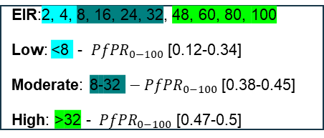
Methods
EIR:2, 4, 8, 16, 24, 32, 48, 60, 80, 100
Low: <8 - ${ PfPR}_{0−100}$ [0.12-0.34]
Moderate: 8-32 ${ − PfPR}_{0−100}$ [0.38-0.45]
High: >32 - ${ PfPR}_{0−100}$ [0.47-0.5]
Notes:
Nobody uses a net in the control scenario, and this is used as the counterfactual to
compare the other scenarios (users and non-users at LLIN usage>0 and different EIR values ) against counterfactual

Slide 13
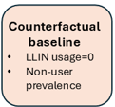
Methods
EIR:2, 4, 8, 16, 24, 32, 48, 60, 80, 100
Low: <8 - ${ PfPR}_{0−100}$ [0.12-0.34]
Moderate: 8-32 ${ − PfPR}_{0−100}$ [0.38-0.45]
High: >32 - ${ PfPR}_{0−100}$ [0.47-0.5]
Cohort Implementation
LLIN users
Non-users
Notes:
In Openmalaria, a cohort is a sub-population which can be monitored separately and can used to target intervention deployment
Nobody uses a net in the control scenario, and this is used as the counterfactual to compare the other scenarios (users and non-users at LLIN usage>0 and different EIR values ) against

Slide 14
Methods
EIR:2, 4, 8, 16, 24, 32, 48, 60, 80, 100
Low: <8 - ${ PfPR}_{0−100}$ [0.12-0.34]
Moderate: 8-32 ${ − PfPR}_{0−100}$ [0.38-0.45]
High: >32 - ${ PfPR}_{0−100}$ [0.47-0.5]
Cohort Implementation
LLIN users
Non-users
Interventions Implemented
CM: 2003-2022
IG2 net: 2023, 2026, 2029
Seed = 10
Pop size: 10’000
Age groups: 0-5, 0-10, 0-100
Notes:
Nobody uses a net in the control scenario, and this is used as the counterfactual to
compare the other scenarios (users and non-users at LLIN usage>0 and different EIR values ) against counterfactual

Slide 15
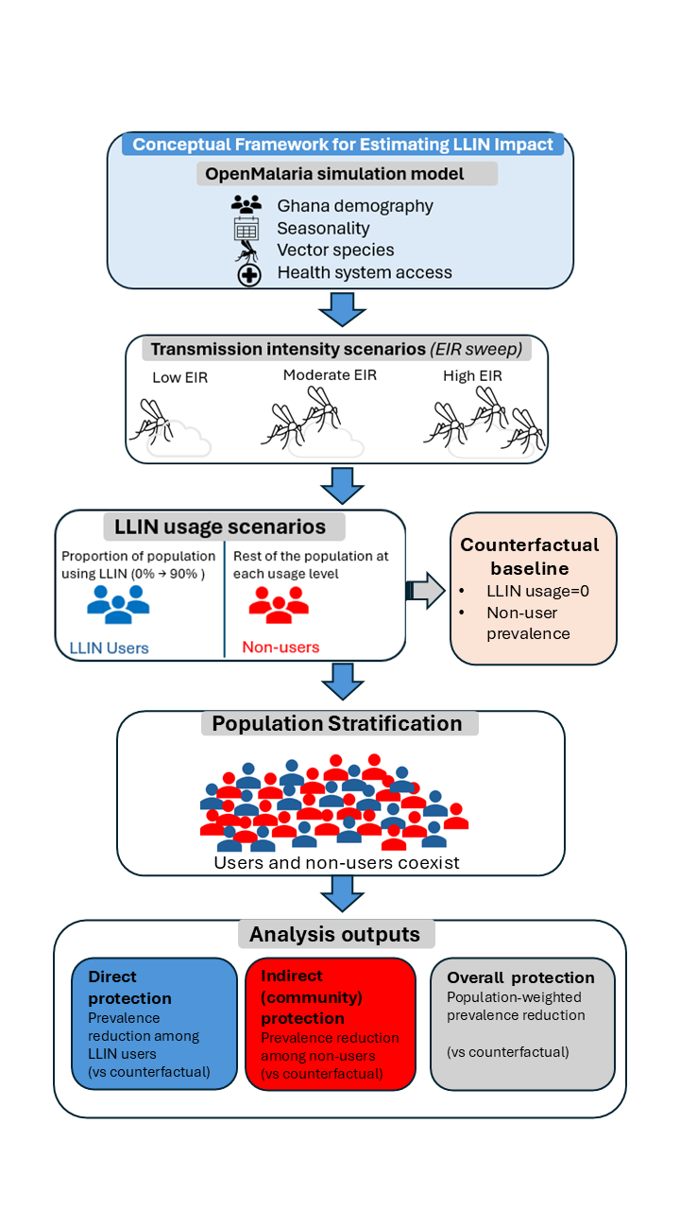

Methods
EIR:2, 4, 8, 16, 24, 32, 48, 60, 80, 100
Low: <8 - ${ PfPR}_{0−100}$ [0.12-0.34]
Moderate: 8-32 ${ − PfPR}_{0−100}$ [0.38-0.45]
High: >32 - ${ PfPR}_{0−100}$ [0.47-0.5]
Cohort Implementation
LLIN users
Non-users
Interventions Implemented
CM: 2003-2022
IG2 net: 2023, 2026, 2029
Seed = 10
Pop size: 10’000
Age groups: 0-5, 0-10, 0-100
Notes:
Nobody uses a net in the control scenario, and this is used as the counterfactual to
compare the other scenarios (users and non-users at LLIN usage>0 and different EIR values ) against counterfactual

Slide 16
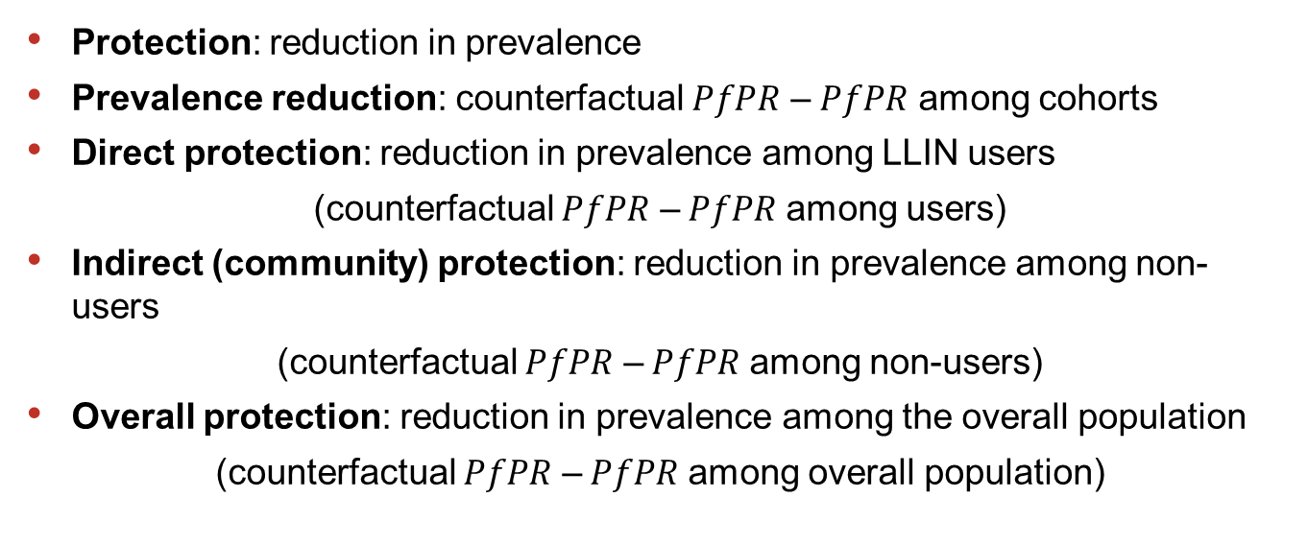
Definitions
Protection: reduction in prevalence
Prevalence reduction: counterfactual $PfPR$ – $PfPR$ among cohorts
Direct protection: reduction in prevalence among LLIN users
(counterfactual $PfPR$ –$PfPR$ among users)
Indirect (community) protection: reduction in prevalence among non-users
(counterfactual $PfPR$ –$PfPR$ among non-users)
Overall protection: reduction in prevalence among the overall population
(counterfactual $PfPR$ –$PfPR$ among overall population)

Slide 17
Results

Slide 18
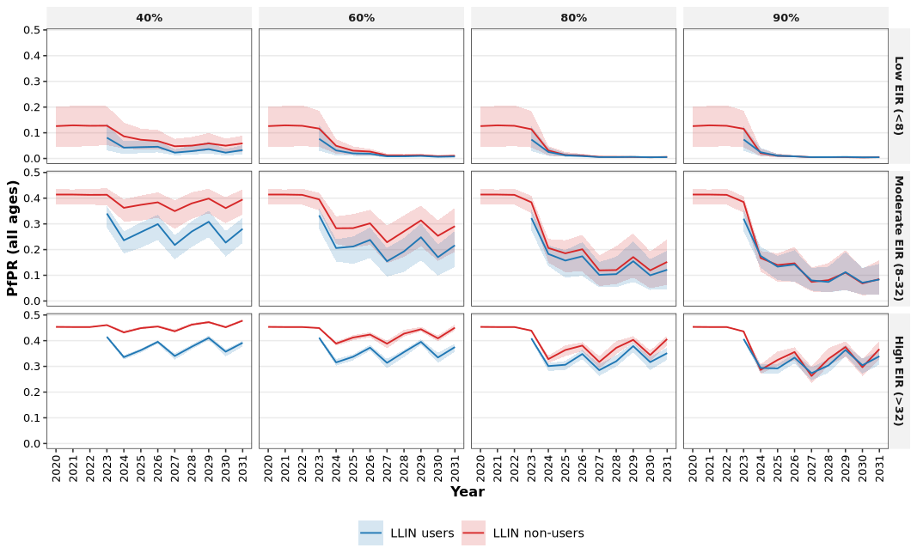
Prevalence declined over time for both users and non-users with increasing LLIN usage - 3 LLIN distribution cycles
Notes:
Temporal trends for two LLIN distribution cycles indicated that malaria prevalence declined over time with increasing LLIN usage across all transmission intensities (EIR), with the steepest declines observed shortly after intervention deployment (Figure 2)

Slide 19
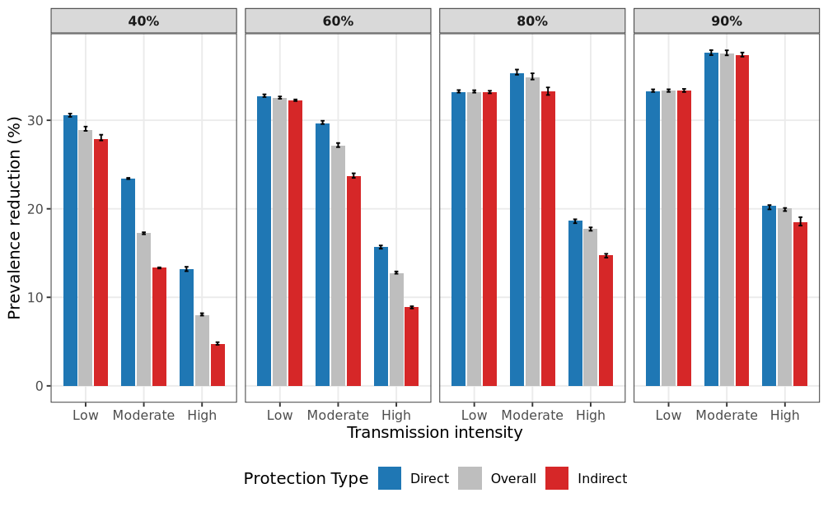
Prevalence reduction (protection)
Notes:
Shows how direct, indirect, and total effects compare at a given usage

Slide 20
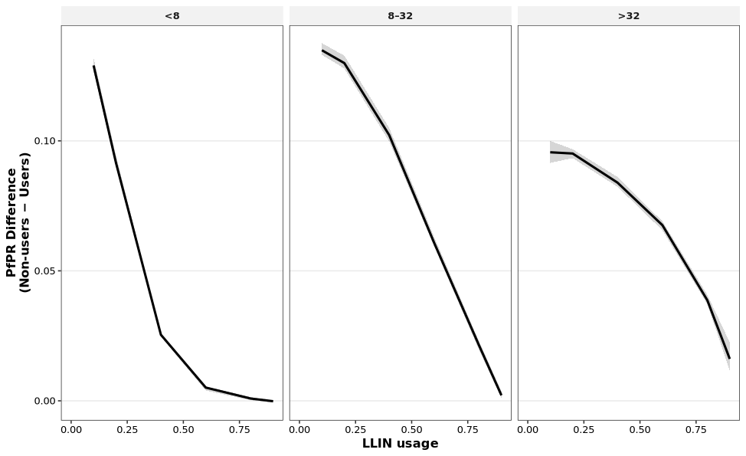
The disparity in infection risk between LLIN users and non-users decreases with increasing usage
Notes:
The disparity in infection risk between LLIN users and non-users decreases with increasing coverage in low-to-moderate transmission settings, indicating convergence driven by community protection. In high transmission settings, substantial risk differentials persist even at high coverage, suggesting that indirect effects are insufficient to equalize infection risk

Slide 21
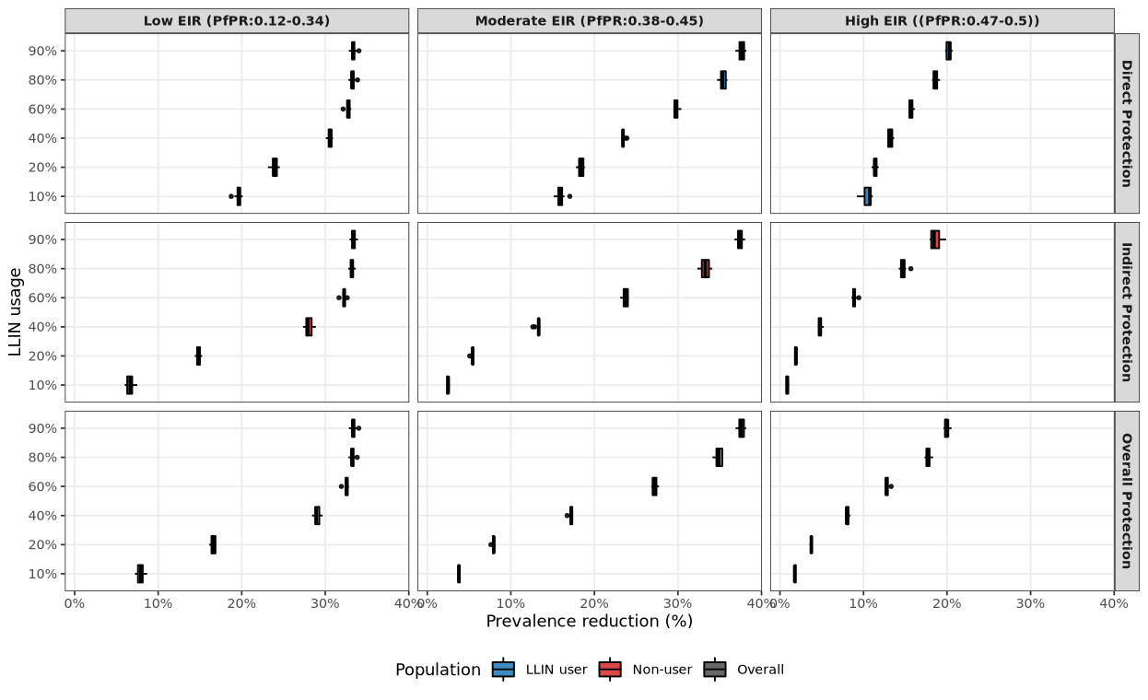
LLINs consistently protect users, and this protection scales with usage regardless of transmission intensity
Notes:
Shows how direct, indirect, and overall effects compare at a given LLIN usage

Slide 22
Protection is strongest and in low-to-moderate transmission settings and becomes harder to achieve as EIR increases
Notes:
Low EIR:
Strong nonlinear increase.
Non-users begin benefiting substantially even at moderate coverage (~40% usage).
Clear evidence of community protection.
Moderate EIR:
Indirect protection is present but requires higher coverage.
Slower increase relative to low EIR.
High EIR:
Indirect protection is weakest and increases more gradually.
Requires very high coverage to achieve meaningful effect

Slide 23
Protection is strongest and in low-to-moderate transmission settings and becomes harder to achieve as EIR increases

Slide 24
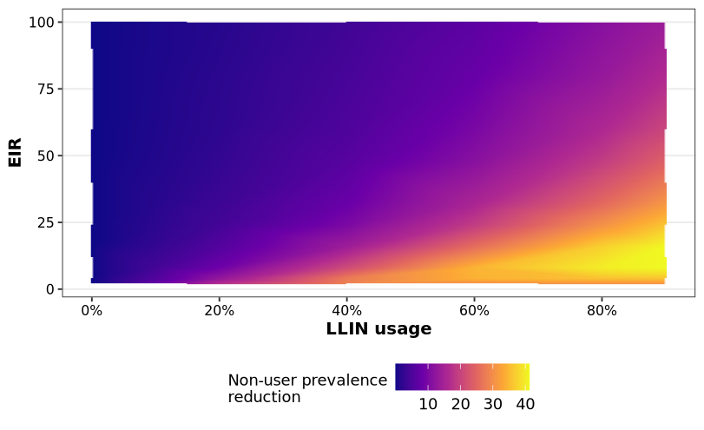
LLIN usage produces strong indirect (community) protection in low to moderate transmission settings
Notes:
Shows how indirect protection behave across the full transmission spectrum
In low transmission settings, LLIN coverage produces strong community-wide suppression
Optimal coverage targets must be transmission-specific.
Uniform national coverage targets may be inefficient.
Extremely high transmission areas require complementary interventions.

Slide 25
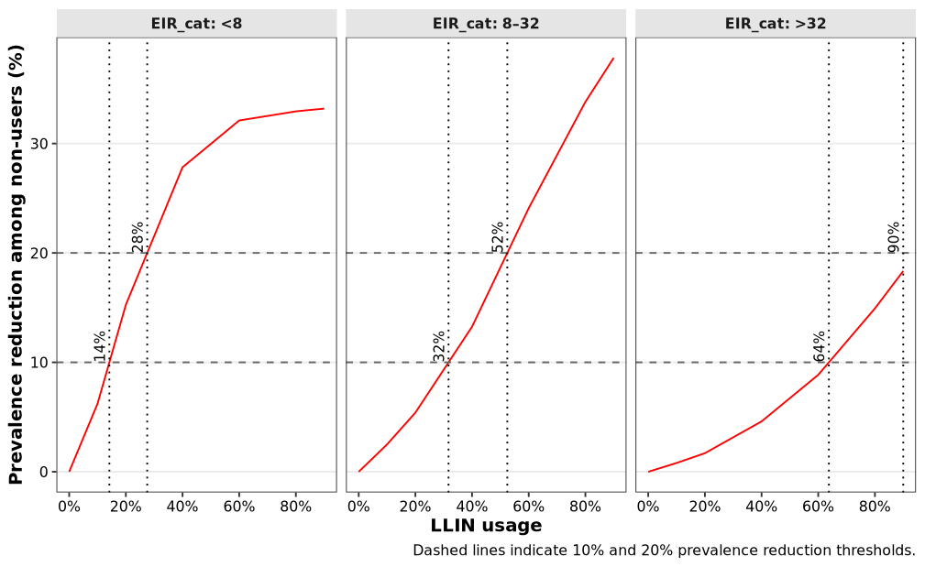
Coverage required to obtain 10% and 20% reductions among non-users
Image caption title.
Notes:
Since we have not identified optimal targets in moderate and high settings, we calculated coverage thresholds required for pre-specified reductions among non-users
Shows how much coverage is needed to achieve a policy-relevant reduction
Low EIR: modest coverage achieves meaningful indirect protection.
Moderate EIR: mid-level coverage (≈50–60%) required for 20% reduction.
High EIR: near-universal coverage required — often unrealistic.

Slide 26
Key messages
LLIN effects are nonlinear
The disparity in infection risk between LLIN users and non-users decreases with increasing coverage
Community protection is transmission-dependent.
Community protection is strongest and most efficient in low-to-moderate transmission settings and becomes harder to achieve as EIR increases
There is no single optimal coverage target in moderate to high transmission settings (no plateau)
High EIR settings do not generate strong community effects without very high coverage
Modest coverage (≈ 30%) is required in low EIR settings to achieve 20% reduction among non-users, whereas mid-level coverage (≈50–60%) required in moderate EIR settings
Notes:
The magnitude and efficiency of community-level protection from LLINs are strongly transmission-dependent, with substantial indirect effects at low-to-moderate EIR but diminishing returns in high transmission settings, implying that optimal coverage targets must be tailored to baseline transmission intensity.

Slide 27
Recommendations
In low EIR settings, maintain ≥ 30–50% effective usage to preserve community protection
Push toward ≥ 50–70% to achieve meaningful indirect effects in moderate settings
Protect gains in low transmission settings
Do not deprioritize LLINs low-transmission areas
Nets alone are not sufficient in high EIR settings, combine with other interventions

Slide 28
Thank you for your attention

